Slide 1
Angular training
Service, HTTP and RxJS

Slide 2
Services in Angular
We have been bundling all our business logic into a single component.
Our application might become unmaintainable very soon.
Angular Dependency Injection (DI) is a mechanism to declare and consume our dependencies across the application with minimum effort and optimal results
We will see how to create an Angular application that is correctly structured to enforce the Separation of Concerns (SoC) pattern using services.
https://angular.io/guide/architecture-services

Slide 3
Service in Angular
•Introducing the Angular DI
•Creating our first Angular service
•Providing dependencies across the application
Injecting services in the component tree

Slide 4
UI and Route
components/header
components/footer
pages/products : products/:id
pages/products-list : ‘’
pages/add-product : /create-product

Slide 5
Introduction to Angular DI
DI is an application design pattern we also come across in other languages, such as C# and Java.
As our applications grow and evolve, each code entity will internally require instances of other objects, better known as dependencies. Passing such dependencies to the consumer code entityis known as an injection, and it also entails the participation of another code entity, called the injector.
The injector is responsible for instantiating and bootstrapping the required dependencies to be ready for use when injected into a consumer. The consumer knows nothing about howto instantiate its dependencies and is only aware of the interface they implement to use them.

Slide 6
Previous products website
In real-world applications, we rarely work with static data. It usually comes from a back end API or some other service.
• The list of products is tightly coupled with the component. Angular components are responsible for the presentation logic and should not be concerned with how to get data.
They only need to display it in the HTML template.
Thus, they should delegate business logic to services to handle such tasks.

Slide 7
MVCSP - MVC (Model , View Controller)
Model .ts
Object representation in .ts / Interface
View (HTML, CSS)
User Interface of the website
Controller (.TS)
The logic of a website.
Service / Provider
Connection to data source
Connection to API
Connection to Local Database (local storage)
Firebase
Data source
For eg: API

Slide 8
Product List
Show all Array of products
Product Service
products : Product[]
addProduct
getAllProducts
getProductById
Product by Id
SHow more info of the chosen product
Add Product
Add an item in the product list

Slide 9
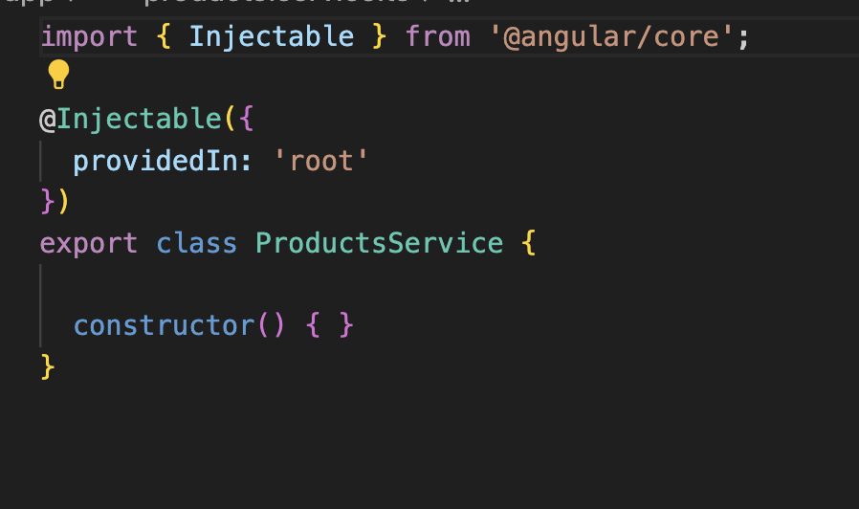
Creating an Angular Service
ng generate service product
ng generate service services/product

Slide 10
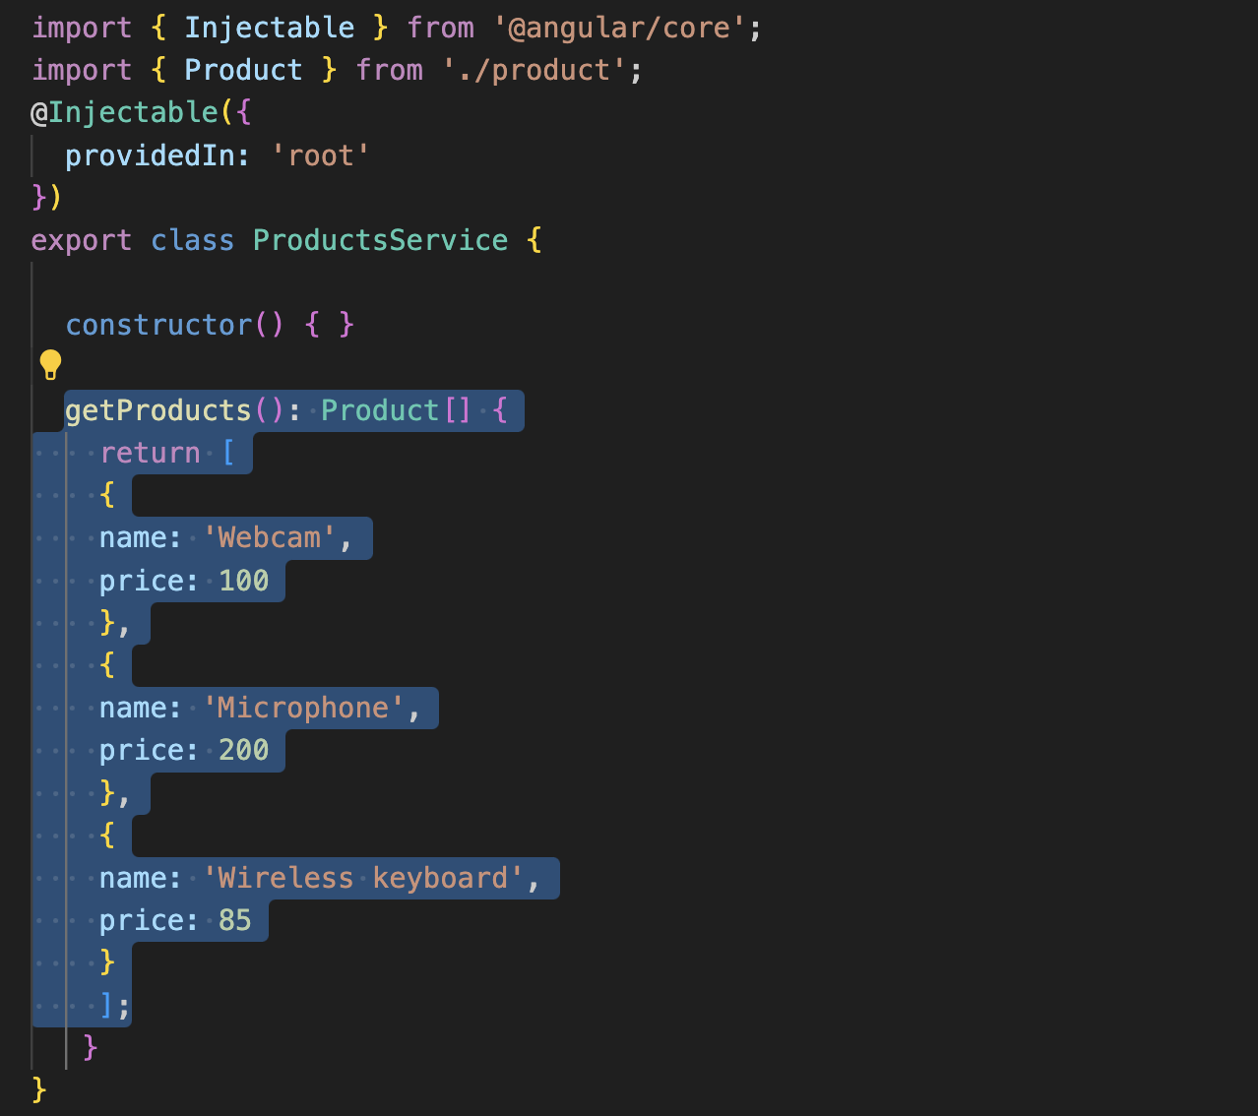
Creating an Angular Service (2)
product.service.ts

Slide 11
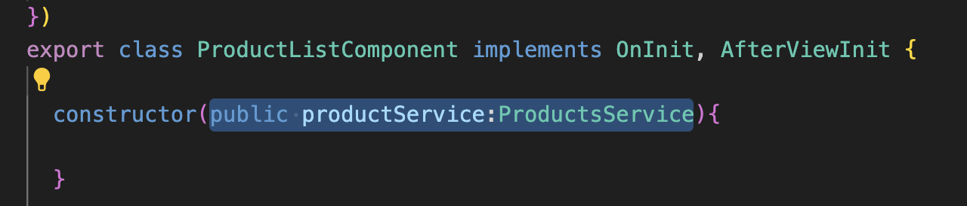
Creating an Angular Service (3)
product-list.component.ts

Slide 12
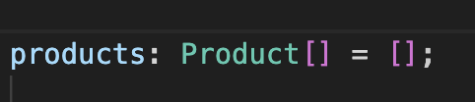
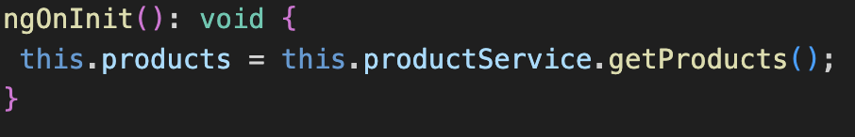
Creating an Angular Service (4)
product-list.component.ts

Slide 13
Observables and RxJS
RxJS (Reactive Extensions for JavaScript) is a library for reactive programming using Observables, making it easier to compose asynchronous or callback-based code.
https://rxjs.dev/
https://playcode.io/rxjs
https://codecraft.tv/courses/angular/reactive-programming-with-rxjs/observables-and-rxjs/

Slide 14
Key concept of RxJS
Observable: Represents a stream of data over time. It can emit multiple values asynchronously.
Observer: Listens to the Observables. It reacts to the data stream by defining functions like next, error, and complete.
Operators: Functions used to manipulate Observables. They allow transforming, filtering, combining, and handling errors in data streams.
Subscription: Represents the execution of an Observable. It can be used to unsubscribe from the Observable to prevent memory leaks.

Slide 15
Creating observables
Creation Functions: RxJS provides various creation functions like of, from, interval, fromEvent, etc., to create Observables from different data sources.
Custom Observables: You can create custom Observables using the Observable constructor or by using the new Observable() syntax.

Slide 16
Subscribing to observables
Use the subscribe() method to start listening to an Observable.
Inside subscribe(), define functions to handle emitted values, errors, and completion of the Observable.

Slide 17
Observables operator
Transformation Operators: Examples include map, pluck, switchMap, mergeMap, etc., which transform the values emitted by an Observable.
Filtering Operators: Examples include filter, take, takeUntil, distinctUntilChanged, etc., which filter the values emitted by an Observable.
Combination Operators: Examples include merge, concat, combineLatest, forkJoin, etc., which combine multiple Observables into a single Observable.

Slide 18
Error handling
Use operators like catchError, retry, finalize, etc., to handle errors in Observables.
Errors can be propagated downstream to subscribers, where they can be handled accordingly.

Slide 19
RxJS use case
HTTP Requests: RxJS is commonly used to handle asynchronous HTTP requests in Angular applications.
Event Handling: RxJS simplifies event handling in web applications by providing operators like fromEvent.
Real-time Data Processing: RxJS is suitable for real-time data processing tasks where data streams need to be processed asynchronously.
Reactive Form in Angular

Slide 20
Example RxJS : creation and subscribe
import {Observable, interval} from 'rxjs';
// CREATION OF OBSERVABLE
const observable = interval(1000); // Every 1s it will bring out number 1,2,3,4,5
// CREATION OF OBSERVER/SUBSCRIVER
const subscription = observable.subscribe(
data => console.log(data),
error => console.log(error),
() => console.log('Complete')
)
// IF we subscribe to an observable, we need to unsubscribe / ngOnDestroy
// There is an async filter that can be used in HTML to manage observable object where you can call it right away and unsubscribe automatically
setTimeout(()=>{
subscription.unsubscribe();
console.log('Unsubscribed')
},10000)

Slide 21
Example : pipe and map
import {Observable, of} from 'rxjs';
import { map } from 'rxjs/operators';
// To transform a data (string,number, array) into observable of() -> A stream of Array
const numbersObservable = of([1,2,3,4,5]);
// pipe - Is used when we want to run an operation from an observable
// map [inside] -> similar to yesterday's concept, it will take a value, each of the value, it will ** 2
// map() - > To transform it back into an observable
const transformedObservable = numbersObservable.pipe(map(numbers => numbers.map(num=>num**2)))
// we subscribed to transformedObservable, for each of the response
// I will show the value
const subscription = transformedObservable.subscribe(
value => console.log(value),
error => console.log(error),
()=> console.log('completed')
)

Slide 22
Example : of and tap
import {of} from 'rxjs';
import { tap } from 'rxjs/operators';
// Creating an observable of 1,2,3,4,5
// nomenclature best practice , observable you will see $ at the end of the name
const sources$ = of(1,2,3,4,5);
// Tap is an operation that you can do multiple thing
// pipe here means I am going to do an observable operation on the data stream
// You can log whatever value that you receive from the data source
// You can transform it at the same time
const tapped$ = sources$.pipe(
tap(value => console.log('Original value:',value)), // Passed value
tap(value=> console.log('Squared value: ', value*value)) // Logged value
);
const subscribed = tapped$.subscribe(
value=> console.log('Received value', value),
error => console.log("error")
)

Slide 23
Integrating with Existing Open API
https://chromewebstore.google.com/detail/json-formatter/bcjindcccaagfpapjjmafapmmgkkhgoa?pli=1
Existing or open APIs refer to application programming interfaces that are publicly available for developers to use in their applications.
These APIs are typically provided by companies, organizations, or service providers to allow developers to access and utilize their services, data, or functionality.
Existing APIs cover a wide range of domains and industries, including social media, weather, maps, payment gateways, messaging, and more.
Most API will require you to register and retrieve the key
Example https://github.com/public-apis/public-apis
Example of Fakestore API:
Retrieve data : GET
https://fakestoreapi.com/products
https://fakestoreapi.com/products/1
Send data : POST
Menghantar borang dan item yang diorder

Slide 24
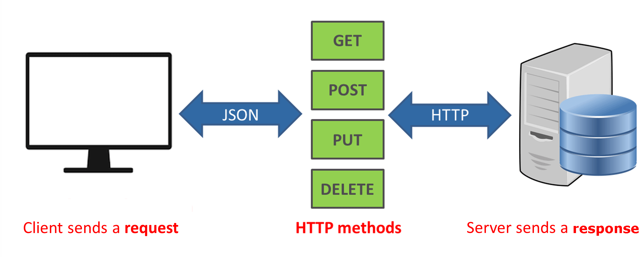

Slide 25
HTTP Methods
HTTP Methods | CRUD Operation | Description
POST | Add (Create) | Add Item inside database
PUT / POST | Edit (Update) | Change an Existing Resource
GET | Retrieve (Read) | Retrieve existing resource
DELETE | Delete (Delete) | Delete existing resource

Slide 26
HTTP Methods example - /hotels
https://github.com/Babunashvili/Books-To-Read-Before-You-Die/blob/master/Ebooks/build-apis-you-wont-hate-everyone-phil-sturgeon(www.ebook-dl.com).pdf
Operation | METHOD | PATH | Send or not send data?
Create | POST | /hotels | YES
Read | GET GET | /hotels /hotels/:id | NO NO
Update | PUT | /hotels/:id | YES
Delete | DELETE | /hotels/:id | NO
The combination of METHOD and PATH cannot be the same

Slide 27
HTTP Methods example - hotels reviews
1 hotel (has many) reviews
https://github.com/Babunashvili/Books-To-Read-Before-You-Die/blob/master/Ebooks/build-apis-you-wont-hate-everyone-phil-sturgeon(www.ebook-dl.com).pdf
Operation | METHOD | PATH | Receive or not receive data?
Create | POST | /hotels/:hotel_id/reviews | YES
Read | GET | /hotels/:hotel_id/reviews /hotels/:hotel)id/reviews/:review_id | NO NO
Update | PUT | /hotels/:hotel)id/reviews/:review_id | YES
Delete | DELETE | /hotels/:hotel)id/reviews/:review_id | NO

Slide 28
Introducing the Angular HTTP client
The built-in HTTP client of the Angular framework is a separate Angular library that resides in the @angular/common npm package under the http namespace.
The Angular CLI installs this package by default when creating a new Angular project.
The HttpClientModule class provides various Angular services we can use to handle asynchronous HTTP communication.
The most basic is the HttpClient service, which provides a robust API and abstracts all operations required to handle asynchronous connections through various HTTP methods.
Its implementation was considered carefully to ensure that developers feel at ease while developing solutions that take advantage of this class.
https://angular.dev/guide/http

Slide 29
Introducing the Angular HTTP client
The HttpClient service have access to various methods to perform common HTTP request operations, such as GET, POST, PUT, and every existing HTTP verb. •
•get: This performs a GET operation to fetch data.
•post: This performs a POST operation to add new data.
•put/patch: This performs a PUT/PATCH operation to update existing data.
delete: This performs a DELETE operation to remove existing data.

Slide 30
URL Used later
Get all products: https://fakestoreapi.com/products [GET]
Get product of particular id: https://fakestoreapi.com/products/1 [GET]
Add a product : https://fakestoreapi.com/products [POST]
Edit a product: https://fakestoreapi.com/products/1 [PATCH/PUT]
Delete a product https://fakestoreapi.com/products/1 [DELETE]

Slide 31
Authentication
https://fakestoreapi.com/auth/login [POST]
Username and password
username: "mor_2314",
password: "83r5^_"
[hardcode this]

Slide 32
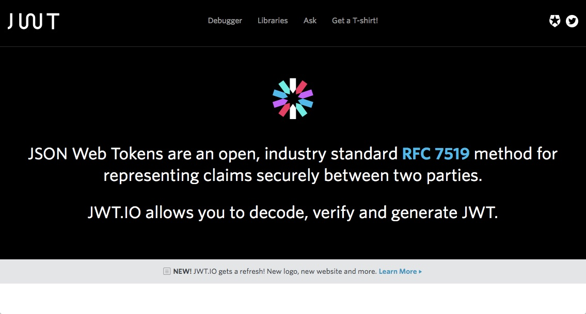

Slide 33
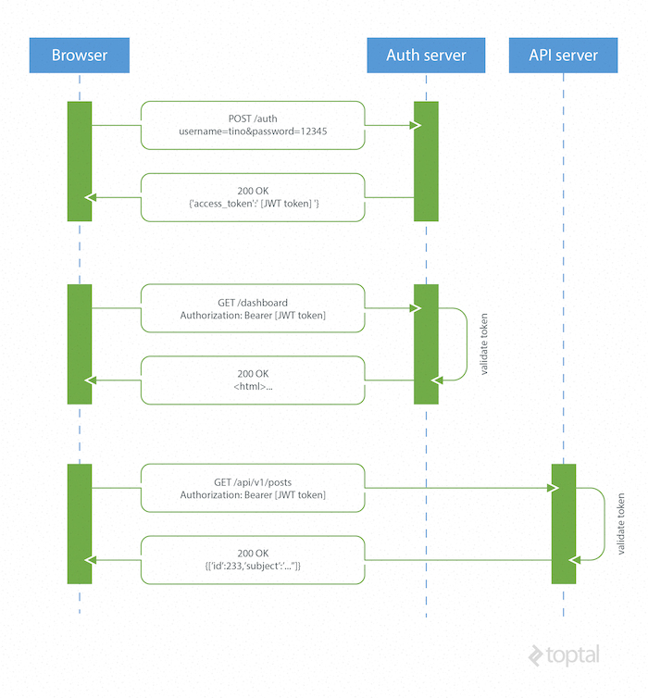
Authentication with JWT

Slide 34
Authentication flow
Client makes a request once by sending their login credentials and password;
Server validates the credentials and, if everything is right, it returns to the client a JSON with a token that encodes data from a user logged into the system;
Client, after receiving this token, can store it the way it wants, whether via LocalStorage, Cookie or other client-side storage mechanisms;
Every time the client accesses a route that requires authentication, it will only send this token to the API to authenticate and release consumption data;
Server always validate this token to allow or block a customer request.

Slide 35
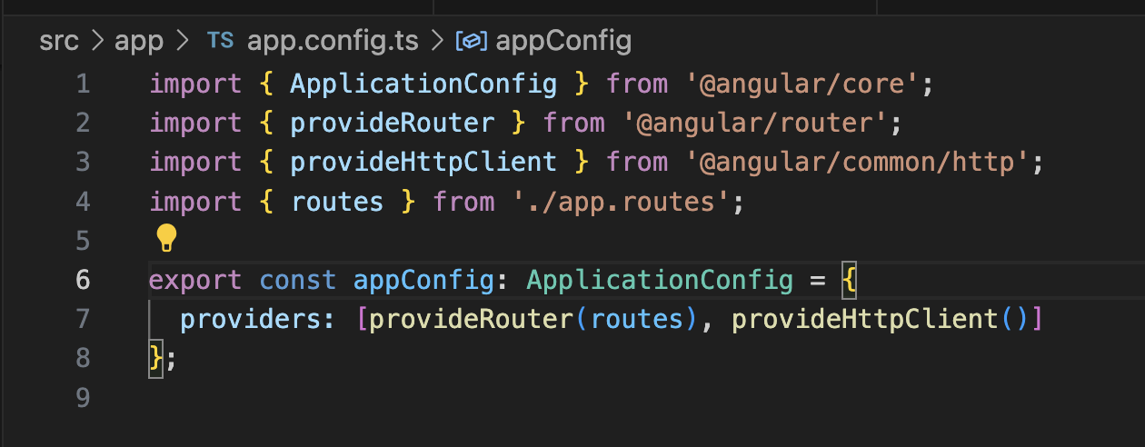
Fetching data through HTTP
app.config.ts

Slide 36
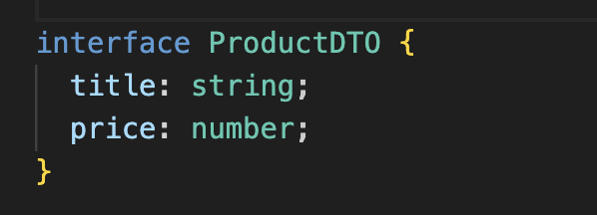
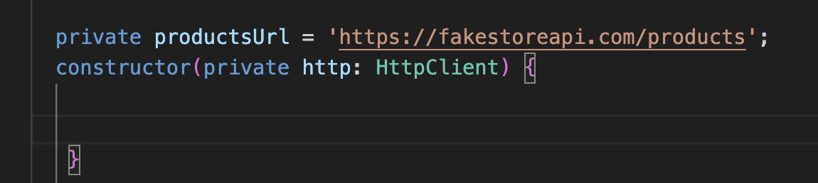
Fetching data through HTTP (1)
product.service.ts

Slide 37
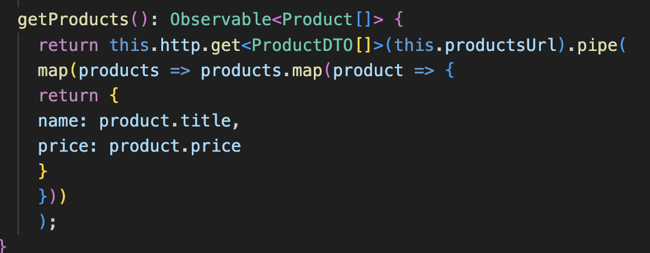
Fetching data through HTTP (2)
product.service.ts

Slide 38
Updated code with comment and more fields based on interface
getProducts():Observable<Product[]>{
// Call the API and get a response of type Array of product
return this.httpClient.get<Product[]>(this.url).pipe(
// Transform it into observable
map(
// for each of the response
// I will transform the response into product object (map)
response => response.map(val =>{
return {
id:val.id,
title:val.title,
price:val.price,
image:val.image
}
})
)
)

Slide 39
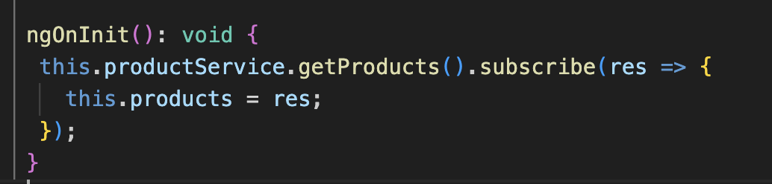
Fetching data through HTTP (3)
product-list.component.ts

Slide 40
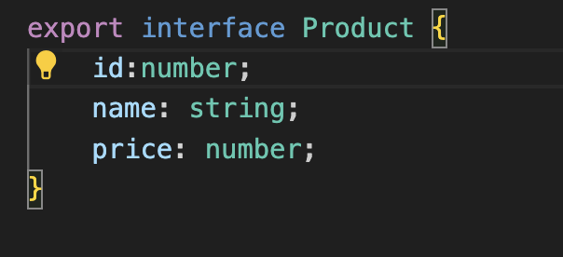
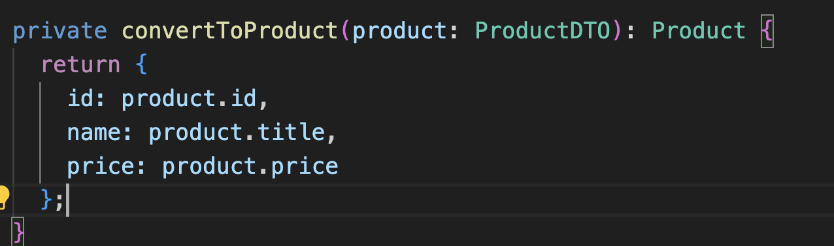
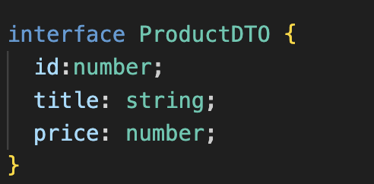
Fetch data by Id through HTTP (1)
product.ts
product.service.ts

Slide 41
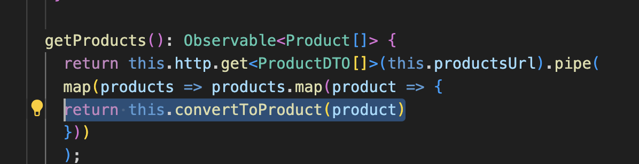
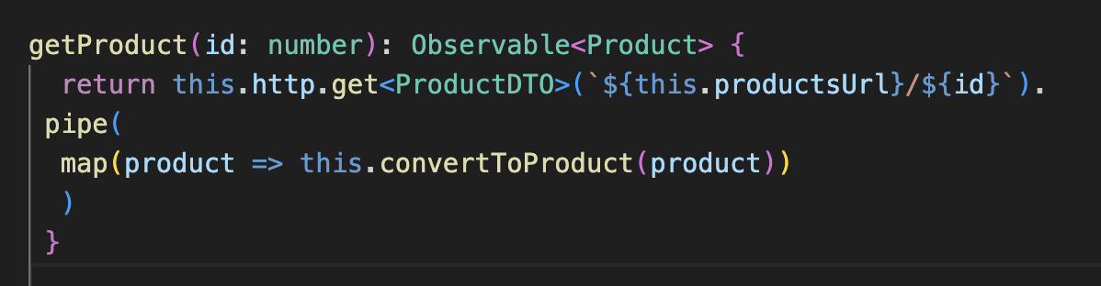
Fetch data by Id through HTTP (2)
product.service.ts

Slide 42
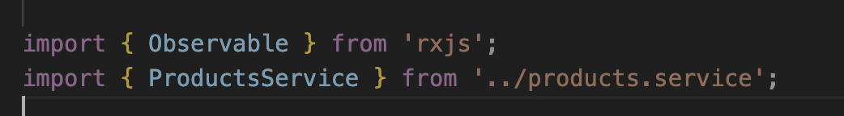
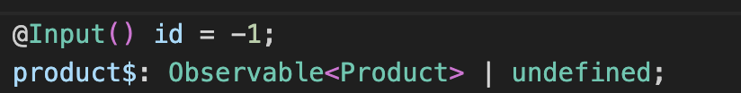
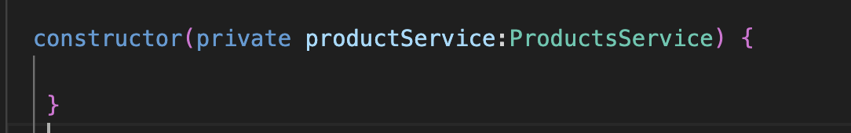
Fetch data by Id through HTTP (3)
product-detail.component.ts

Slide 43
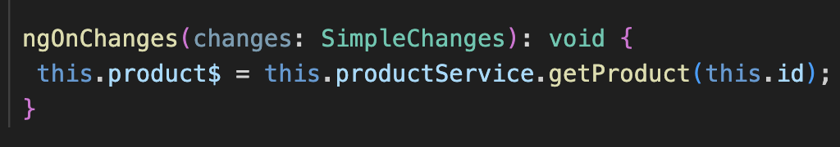
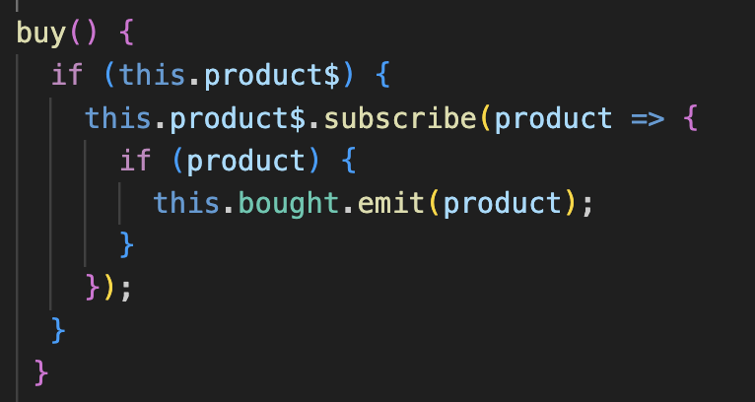
Fetch data by Id through HTTP (4)
product-detail.component.ts

Slide 44
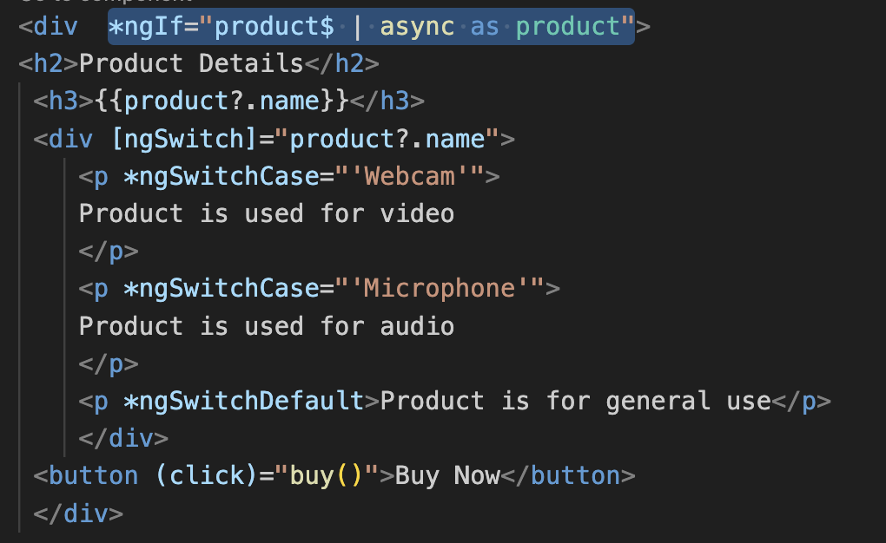
Fetch data by Id through HTTP (5)
product-detail.component.ts

Slide 45
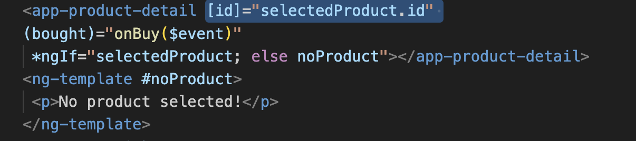
Fetch data by Id through HTTP (6)
product-list.component.html

Slide 46
Modifying Data through HTTP
Modifying data in a CRUD application usually refers to adding new data and updating or deleting existing data. To demonstrate how to implement such functionality in an Angular application using the HttpClient service, we will make the following changes to our application:
Create an Angular component to add new products.
• Modify the product detail component to change the price of an existing product.
• Add a button in the product detail component for deleting an existing product.

Slide 47
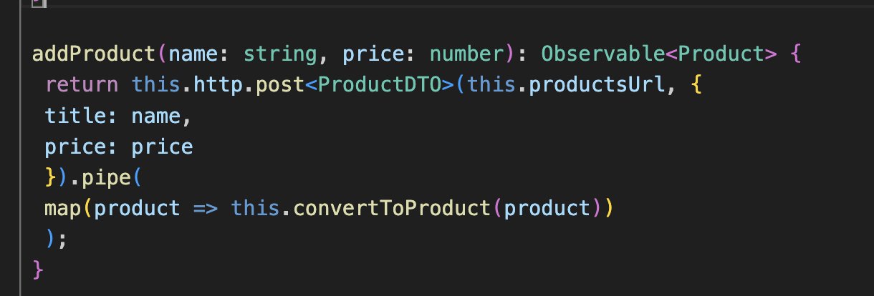
Add new product
product.service.ts

Slide 48
Add new product (2)
Generate new component:
ng generate component product-create

Slide 49
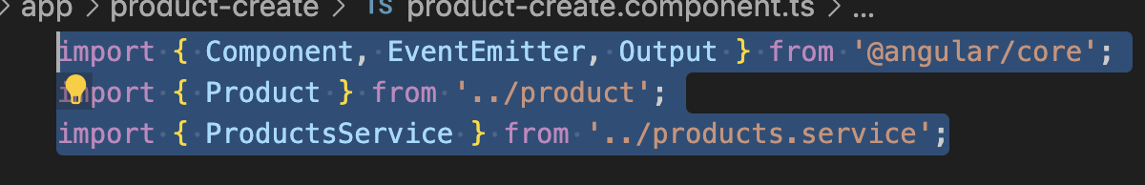
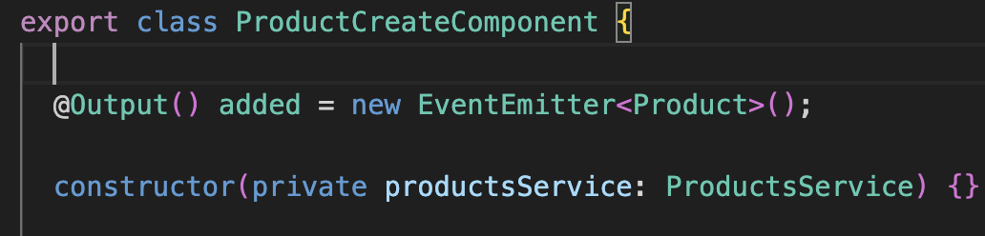
Add new product (3)
product-create.component.ts

Slide 50
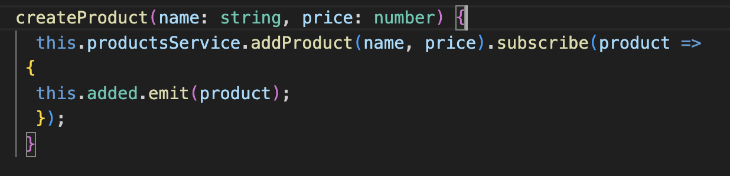
Add new product (4)
product-create.component.ts

Slide 51
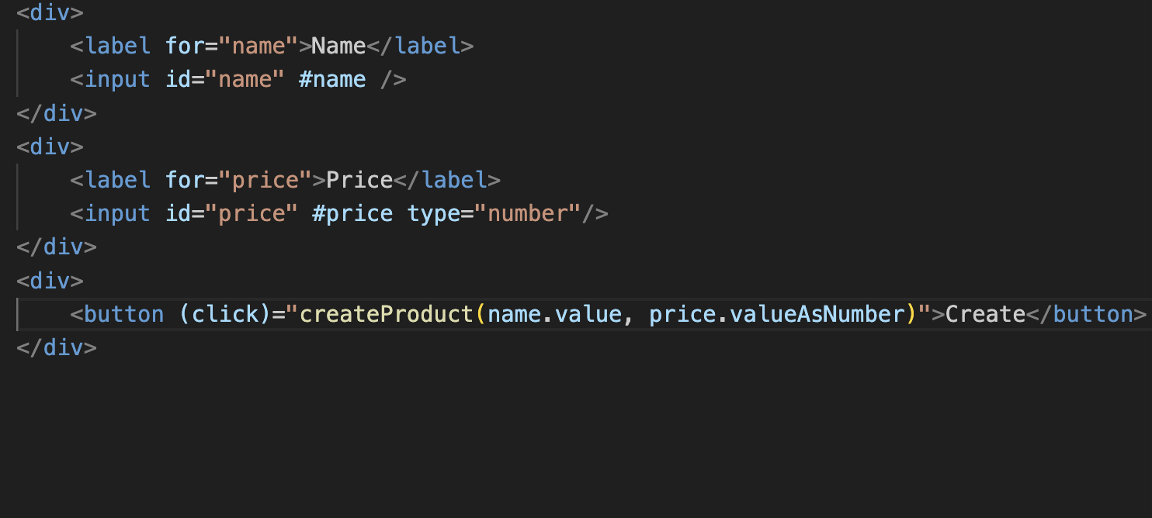
Add new product (5)
product-create.component.html

Slide 52
Add new product (5)
product-create.component.html

Slide 53
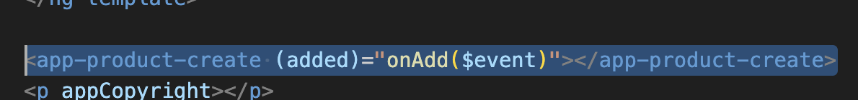
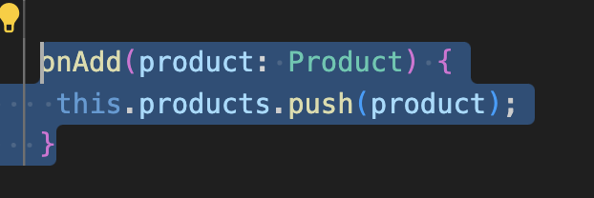
Add new product (6)
Product-list.component.html
product-list.component.ts

Slide 54
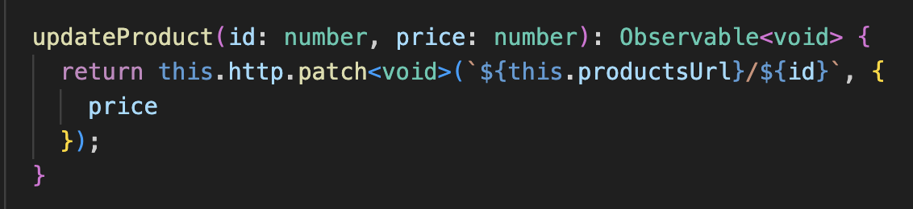
Updating product price
product.service.ts

Slide 55
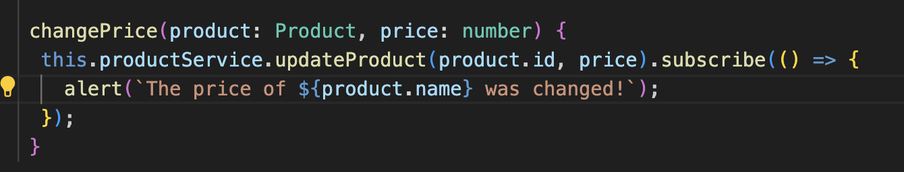
Updating product price (2)
product-detail.component.ts

Slide 56
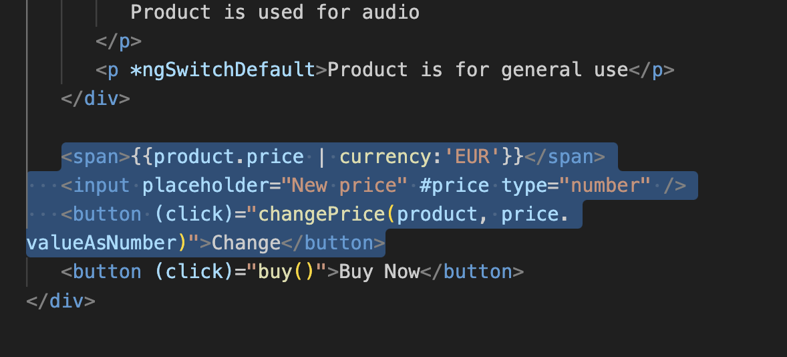
Updating product price (3)
product-detail.component.ts

Slide 57
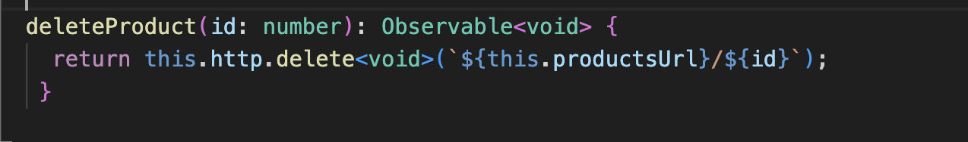
Removing a product (1)
product.service.ts

Slide 58
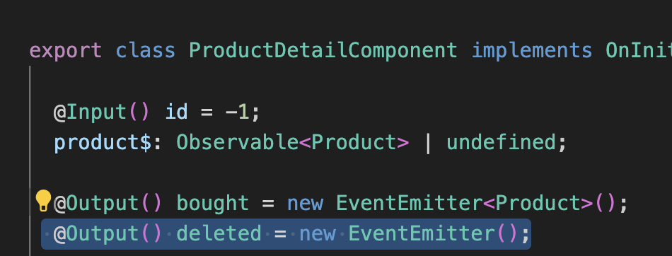
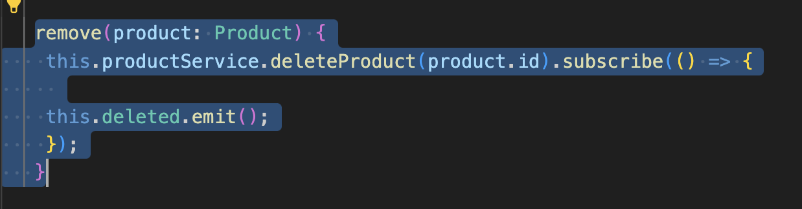
Removing a product (1)
product-detail.component.ts

Slide 59
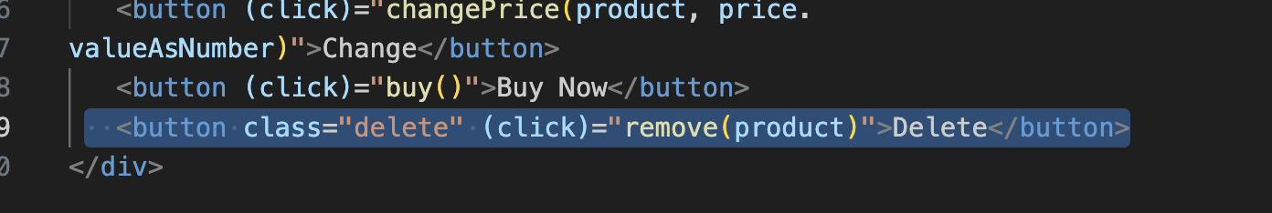
Removing a product (2)
product-detail.component.html

Slide 60
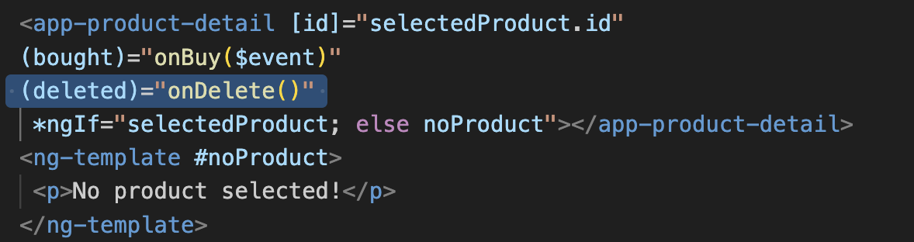
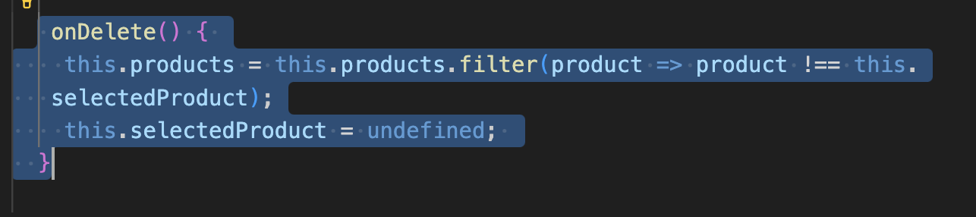
Removing a product (3)
product-list.component.html
product-list.component.ts

Slide 61
Authentication and Authorization
We will explore the following authentication and authorization topics in this section using the fakestoreapi.com
• Authenticating with a backend API
• Authorizing users for certain features
• Authorizing HTTP requests using interceptors

Slide 62
Authentication and Authorization (2)
Generate new service that will handle the authentication and authorization:
ng generate service auth

Slide 63
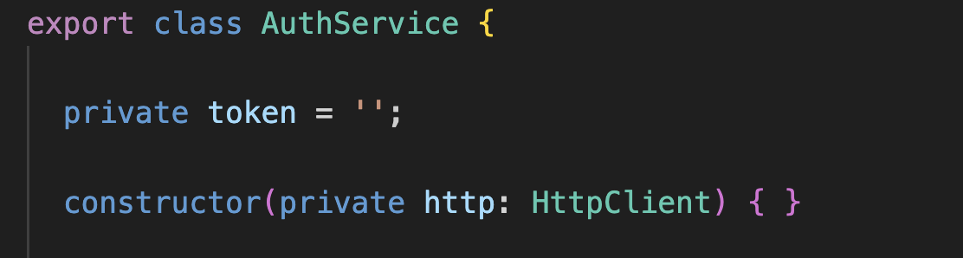
Authentication and Authorization (3)
Create a private property token and inject HttpClient inside it

Slide 64
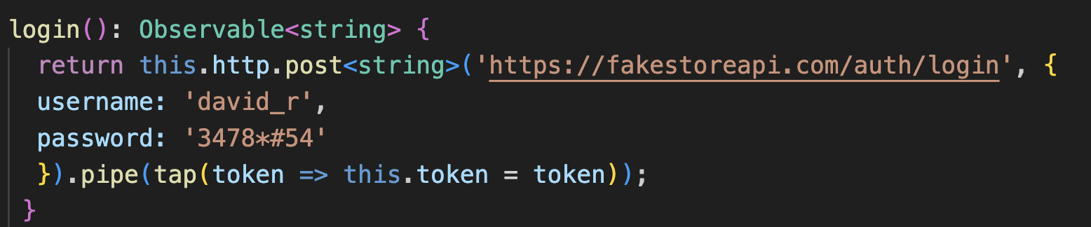
Authentication and Authorization (4)
Create a login method in the service

Slide 65
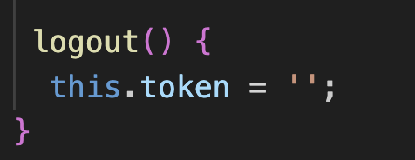
Authentication and Authorization (5)
Create a logout method on the token

Slide 66
Authentication and Authorization (6)
Create a new auth component to simulate login and logout
ng generate component auth

Slide 67
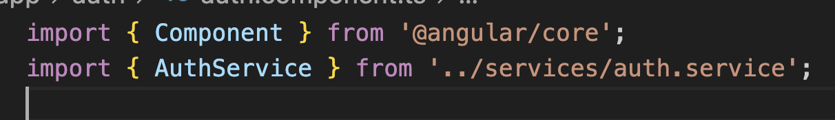
Authentication and Authorization (6)
Import and inject the auth.service inside the component:
auth.component.ts

Slide 68
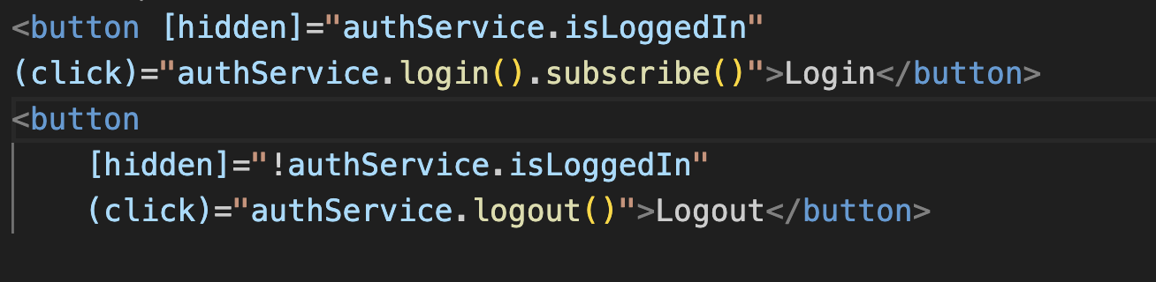
Authentication and Authorization (7)
Create the UI for the login and logout
auth.component.html

Slide 69
Authentication and Authorization (8)
Create a getter to verify the token existence in the service
auth.service.ts

Slide 70
Authentication and Authorization (9)
In product detail, simulate a “only logged in scenario”, for example the buy button can only be pressed after log in
product-detail.component.html

Slide 71
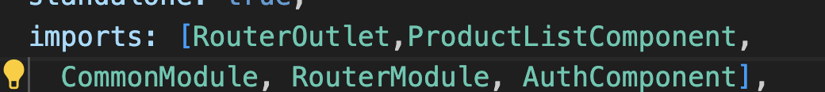
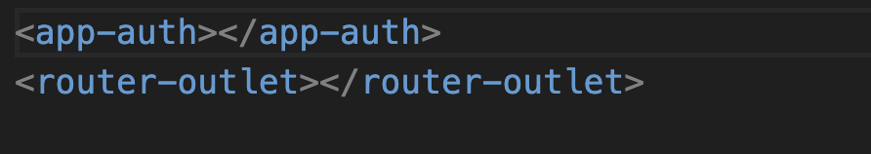
Authentication and Authorization (10)
Add the AuthComponent on app.component.html

Slide 72
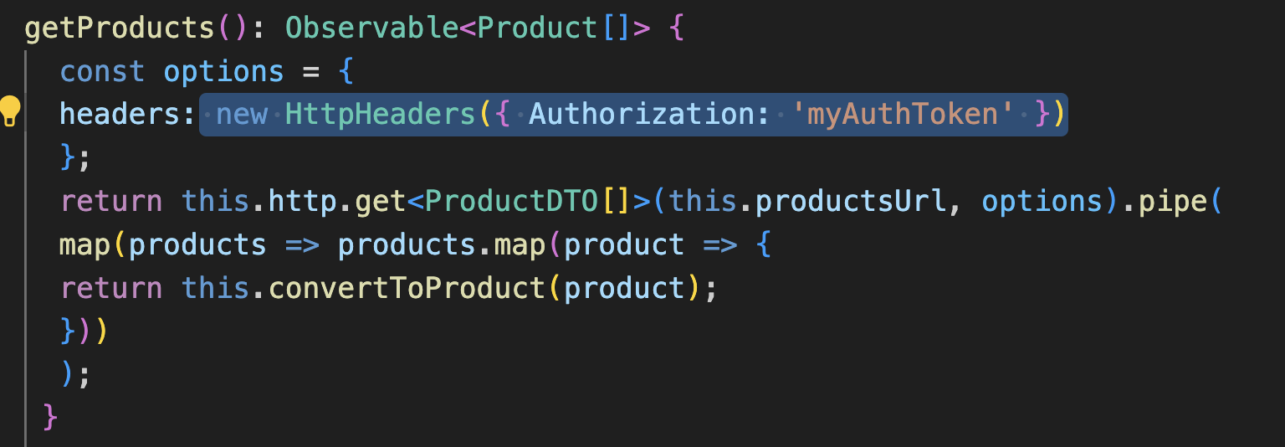
Authorizing Http Request
A common pattern in web applications is to include the token in an Authorization header.
We can use HTTP headers in an Angular application by importing the HttpHeaders artifact from the @angular/common/http namespace and modifying our methods accordingly:

Slide 73
Interceptor
An HTTP interceptor is an Angular service that intercepts HTTP requests and responses that pass through the Angular built-in HTTP client. It can be used in the following scenarios:
• When we want to pass custom HTTP headers in every request, such as an authentication token.
• When we want to display a loading indicator while we wait for a response from the server.
• When we want to provide a logging mechanism for every HTTP communication.
https://angular.io/guide/http-interceptor-use-cases

Slide 74
Interceptor (2)
Generate a new interceptor
ng generate interceptor auth

Slide 75
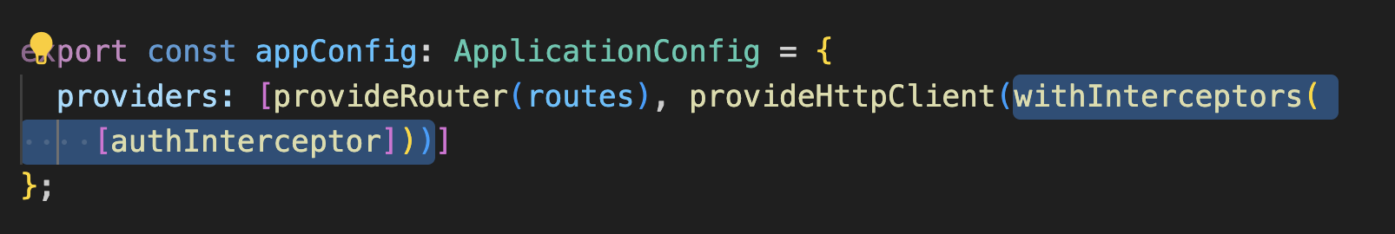
Interceptor(3)
Add interceptor in app.config.ts

Slide 76

Interceptor (4)
The generated function HttpInterceptorFn accepts the following parameters:
req: An HttpRequest object that indicates the current request
• next: An HttpHandler object that denotes the next interceptor in the chain

Slide 77

Interceptor (5)

